Slide 1

Elbow Method in K-Means Algorithm

Slide 2

Elbow method:
The Elbow Method is a technique used to determine the optimal number of clusters (K) in a K-Means clustering algorithm. It works by calculating the Within-Cluster Sum of Squares (WCSS) for different values of K and plotting them on a graph.
As K increases, the WCSS decreases. However, after a certain point, the rate of decrease slows down — forming a shape like an "elbow" in the plot. The value of K at this elbow point is considered the optimal number of clusters because it balances low WCSS and model simplicity.

Slide 3
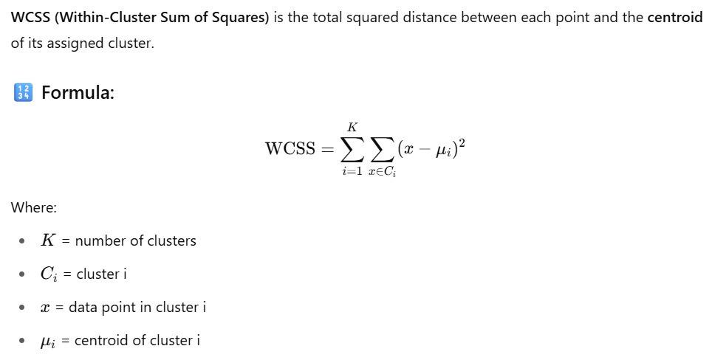
Elbow method:

Slide 4
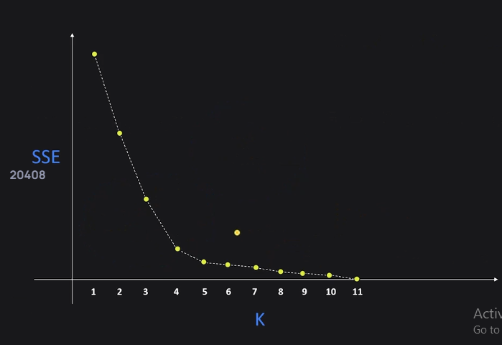
Elbow method:

